Slide 1

Building a Modern Marketing Strategy
Stop posting blindly. Start with purpose — and build a strategy that actually drives customers and revenue.

Slide 2

Start With the Goal, Not the Platform
Don't start with "We need to post more on Instagram." Start here:
What are you trying to accomplish?
Who are you trying to reach?
What action do you want them to take?
What does success look like?
Likes and followers support marketing — but the real goal is customers and revenue.

Slide 3
Marketing Works Best as an Ecosystem
No single channel does it all. Your customer's journey looks like this:
See You on Social
Google You
Visit Your Website
Read Reviews
Get an Email
Contact You
Every touchpoint reinforces the next. That's an ecosystem, not a checklist.

Slide 4
Choose the Right Platforms
You don't need six platforms. You need the right ones.
Facebook — Local businesses, community, events
Instagram — Visual brands, lifestyle, awareness
LinkedIn — B2B, professionals, networking
TikTok — Discovery, personality, younger audiences
YouTube — Education, expertise, search visibility
Pinterest — Inspiration, home, design, lifestyle

Slide 5




What Should You Actually Post?
Four content buckets — balanced, purposeful, never random.
Educate
Build Trust
FAQs, tips, how-tos
Reviews, testimonials, behind the scenes
Connect
Sell
Team, personality, community
Services, offers, appointments

Slide 6
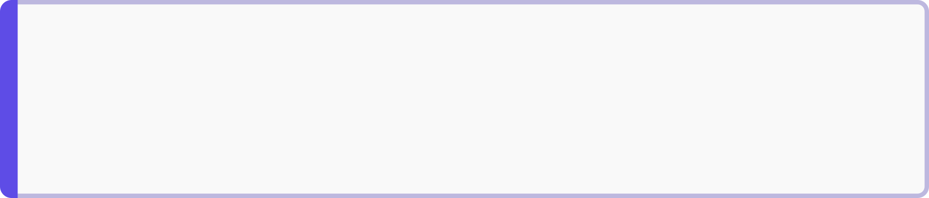
AWARENESS VS. INTENT
Social + Google: Both Are Essential
📱 Social Media — Awareness
🔍 Google Search — Intent
"I wasn't looking for you — but you caught my attention."
"I have a problem and I'm actively looking for a solution."
You need both awareness and intent marketing working together.

Slide 7

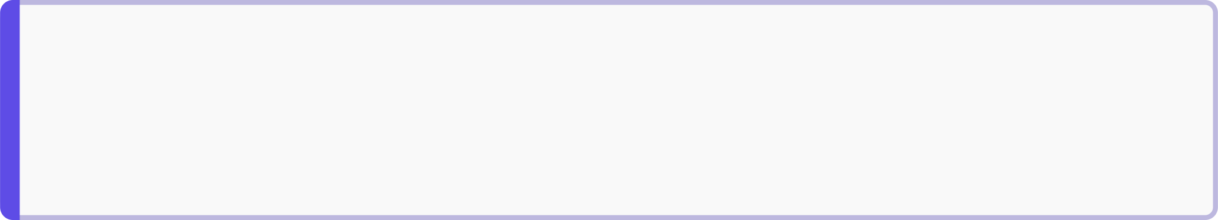
SEO → GEO → AI Search
People aren't only Googling anymore. They're asking ChatGPT and Gemini for recommendations.
SEO
Appear in traditional search engines
GEO / AI Search
Help AI platforms trust and reference your business
Your Website
The hub — owned, not rented

Slide 8
Content That Stays Relevant
Use AI to discover what your audience is already searching for — then show up with the answer.
AI-POWERED RESEARCH
Find What's Trending
Ask the right questions
Spot patterns & plan
Post, measure, repeat
Prompt AI: "What are the top questions people in [your industry] are asking right now?"
Find repeating themes across searches — these become your content pillars and calendar.
Track engagement and double down on the topics that resonate most.

Slide 9
Measure, Learn & Adjust
Marketing isn't a one-time launch — it's a loop. Data tells you what's working, what to stop, and where to double down.
📊 Social Media
🌐 Website
Engagement rate
Click-throughs to website
Traffic & unique visitors
Bounce rate
🎯 Conversions
⭐ Reputation
Leads generated
Sales closed
Average star rating
Referrals received
Marketing is iterative. Keep testing, learning, and adjusting — not setting and forgetting.

Slide 10

Your Review Cycle
1
2
3
Weekly (15 min)
Monthly (1 hour)
Quarterly (half day)
Check social engagement, ad spend & new reviews. Respond and flag anything unusual.
Review traffic, leads & conversions. Compare to last month. Spot your best and worst channels.
Audit your full strategy. Shift budget toward what's working. Cut what isn't.
🛠️ Tools: Google Analytics · Google Search Console · Meta Business Suite · Google Business Profile Insights
Marketing is iterative. Every data point is feedback. Keep testing, learning, and adjusting — don't set it and forget it.

